Slide 1
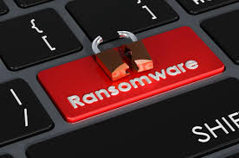
Ransomware and Least Privilege
Ethical Hacking & Countermeasures | Brian F. Smith

Slide 2
Introduction: Ransomware and Least Privilege
What is ransomware?
Ransomware is a type of malware that encrypts a company's files and demands a ransom payment to restore access. It often spreads through phishing emails, compromised software, or vulnerable systems and is especially dangerous when targeting shared network resources
Why does Ransomware Target Shared Folders?
Shared folders are frequently accessed by multiple users, increasing the likelihood of infection
Inadequate permissions often allow ransomware to encrypt all files in a shared folder
Businesses that depend on shared files for collaboration and daily tasks can be brought to a standstill by ransomware
What is Least Privilege, and why is it important?
The principle of least privilege (PoLP) is a critical defense against ransomware
It limits the access each user or process has to files and directories, reducing the spread of ransomware within a network
Implementing PoLP properly can significantly reduce a company’s vulnerability to ransomware attacks
In ethical hacking and penetration testing, enforcing PoLP helps ethical hackers demonstrate how effective permission management can contain an attack

Slide 3

How does File Sharing Work in Windows Server?
File Sharing Process:
When I set up file sharing in Windows Server, I went through several steps, including user account creation, folder sharing, and setting permissions
I’ve found that permissions are the most critical part because they control who can read, write, or modify shared files
Why Permissions Matter:
Improper permissions are one of the leading causes of ransomware spreading
By carefully managing access, we can better protect shared folders

Slide 4
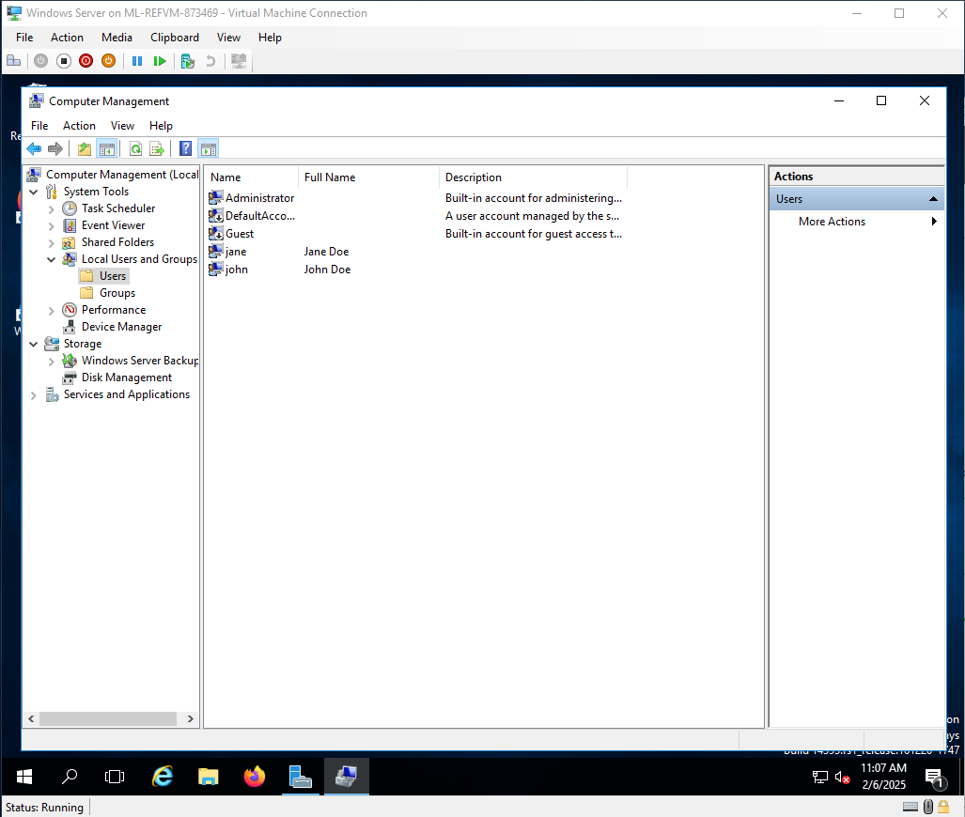
Creating Local User Accounts on Windows Server
I started by opening Active Directory Users and Computers on the VM server
From there, I right-clicked on "Users," selected "New," and chose "User."
I created accounts for Jane Doe and John Doe, assigned passwords, and ensured the accounts had the correct basic permissions.
Next i would start to set up the department that these users were assigned to

Slide 5
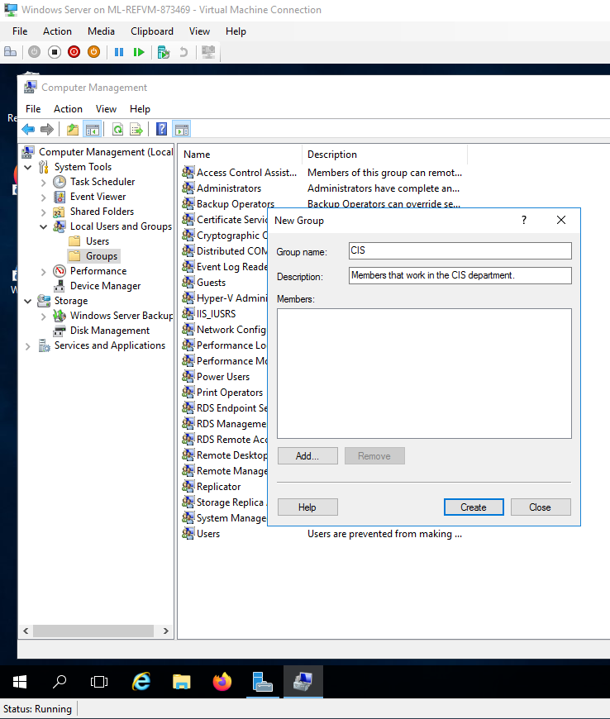
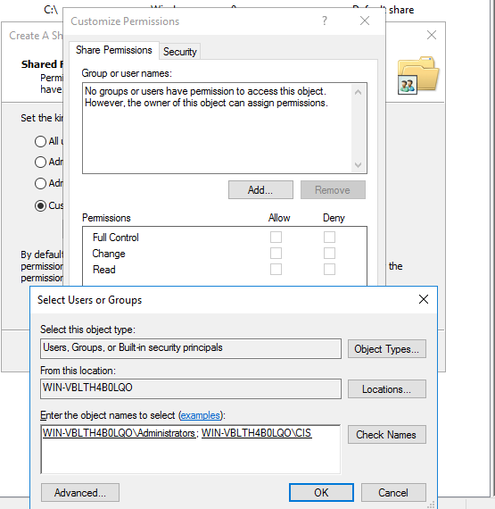
Creating Groups in Windows Server
The screenshot below shows the setup for a shared folder.
In Windows Server, I created a group called “CIS” by right-clicking on "Users" in Active Directory and selecting "New Group." Then, I added Jane and John as members of the group.
By using groups, I can control permissions more efficiently. Instead of managing individual accounts, I can assign permissions at the group level. This makes it easier to implement PoLP across a workgroup.

Slide 6
Setting Up a Shared Folder
Now that I created my group, I wanted to create a shared folder in which they could access common resources
I created a folder named "CIS" in the C:\ directory
I right-clicked on it, selected “Properties,” → “Sharing” → “Advanced Sharing”
I shared the folder and named it “CIS”
I set the folder’s share and NTFS permissions based on the roles of Jane and John
Controlling both types of permissions is necessary to enforce PoLP →
In the next slide, I show my use of the “Customize Permissions” dialog box for a shared folder.
The CIS group has been granted "Change" and "Read" permissions, allowing them to modify and read files but not alter folder permissions or take ownership
Administrators have Full Control, meaning they can read, modify, delete, and manage folder permissions
This permission structure helps enforce PoLP by limiting CIS users' ability to change security settings while still allowing file collaboration
The setup reduces the impact of ransomware by ensuring that non-administrative users cannot escalate privileges or alter folder access settings

Slide 7
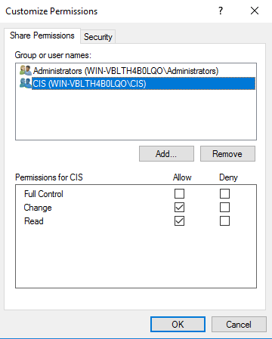
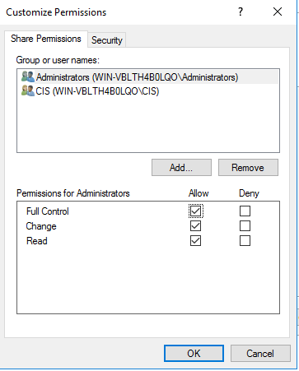

Slide 8
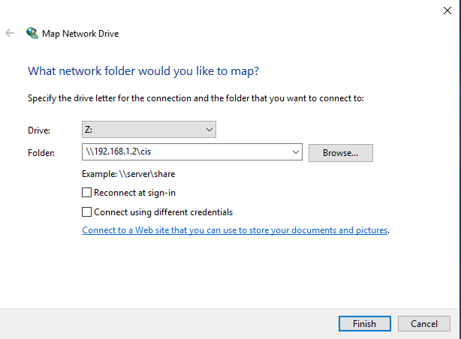
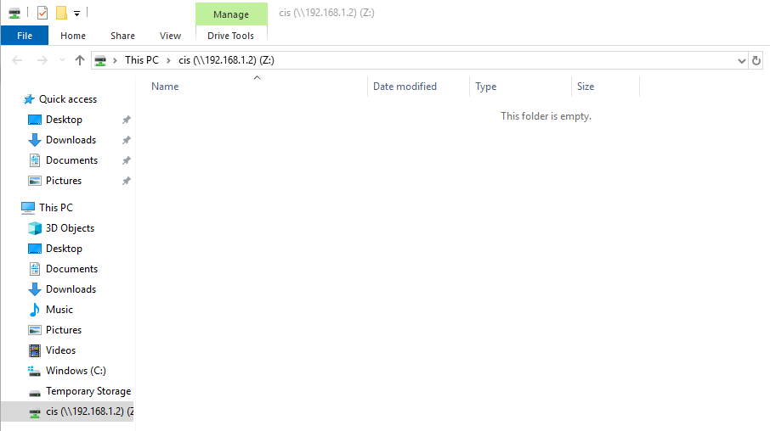
Connecting to the Shared Folder from Client Machine
To ensure the client machine (my Azure VM) could connect to the shared folder, I reviewed the firewall settings and have enabled file sharing rules:
From the client machine, I opened File Explorer and connected to the shared folder by typing \\192.168.1.2\cis
I clicked “Connect using different credentials” to log in under one of the users I previously created and assigned to the CIS group
I successfully authenticated as Jane and accessed the shared folder

Slide 9
Understanding Normal Folder Permissions
What happens when you change each one of the normal permissions on the folder?
I explored several permission options in Windows Server:
Full Control: Allows all actions, including deleting and modifying files
Change: Users can change content but not modify ownership
Read: Users can only view files
Read & Execute: Users can view and run files but can’t make changes
Write: Allows adding or modifying files but doesn’t allow reading others
Its critical to assign the correct permissions to protect files and prevent unauthorized changes
If users are given "Full Control," they can modify permissions or take ownership of files, increasing the risk of exploitation during ransomware attacks.
Ransomware can encrypt all files a user has access to. If the user has "Full Control," every file in the folder could be encrypted, crippling the organization
By restricting users to "Read" or "Change" only, I can limit the ability to spread malware, reducing the damage to files in case of an attack

Slide 10
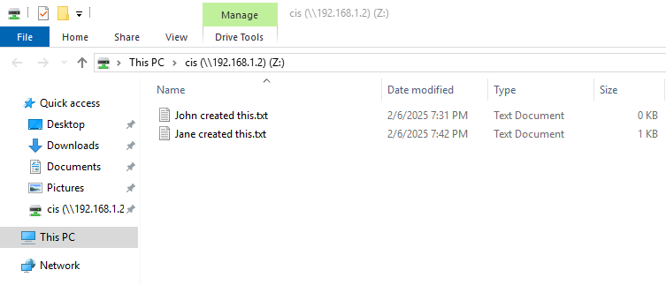
How Permissions Affect Files in a Shared Folder
The next slides demonstrate the following use cases of folder permissions, and their best practices:
Creating Documents and Allowing Others to Read
Editing Existing Documents
Collaborative Document Creation and Edits
By adjusting permissions on the CIS shared folder, I can control who can modify, read, or delete Jane and John’s files.

Slide 11
Best Practices for Folder Permissions: Use Cases 1-3
Use Case 1: Creating Documents and Allowing Others to Read
Jane and John Doe can create a document titled "John Created This.txt" and "Jane Created This.txt" in the CIS shared folder
Recommendations:
Grant "Modify" or "Change" permissions only to Jane and John for their own files. For everyone else, grant "Read" permission to allow document visibility but prevent unauthorized changes
Security Benefit:
Ensures document creators retain control over their files, while others can access them without modifying content
Use Case 2: Editing Existing Documents
If Jane or John needs to open an existing document and make edits, they should have "Change" or "Modify" permissions on those files.
Recommendations:
Grant "Change" permission to users who need editing capabilities. This allows them to read, update, or delete document content, while still preventing permission changes
Security Benefit:
Allows for collaborative editing but keeps administrative settings secure
Use Case 1: Collaborative Document Creation and Edits
When Jane and John are creating new documents for team collaboration, they may need to grant full editing rights to other CIS group members.
Recommendations:
Assign "Change" or "Modify" permissions to the group. This allows users to create, read, update, and delete files without altering folder security settings
Security Benefit:
Provides flexibility for collaborative work while mitigating the risk of accidental or unauthorized permission changes
Screenshots demonstrating this are on the next slide.

Slide 12
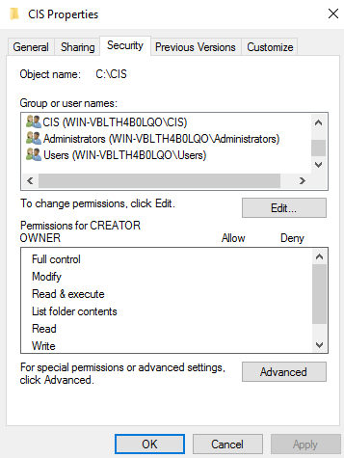
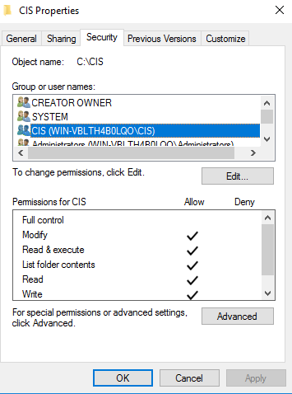
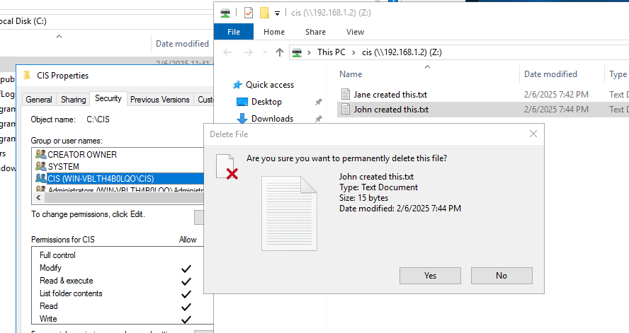
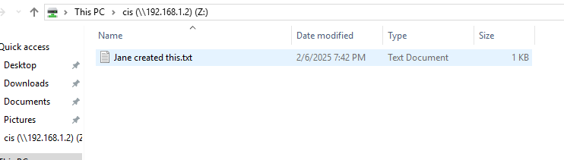
3
1
2
Permissions dialog box
Changing perm. for CIS
Attempting to delete file with new permissions
Deletion worked due to permission changes
4

Slide 13
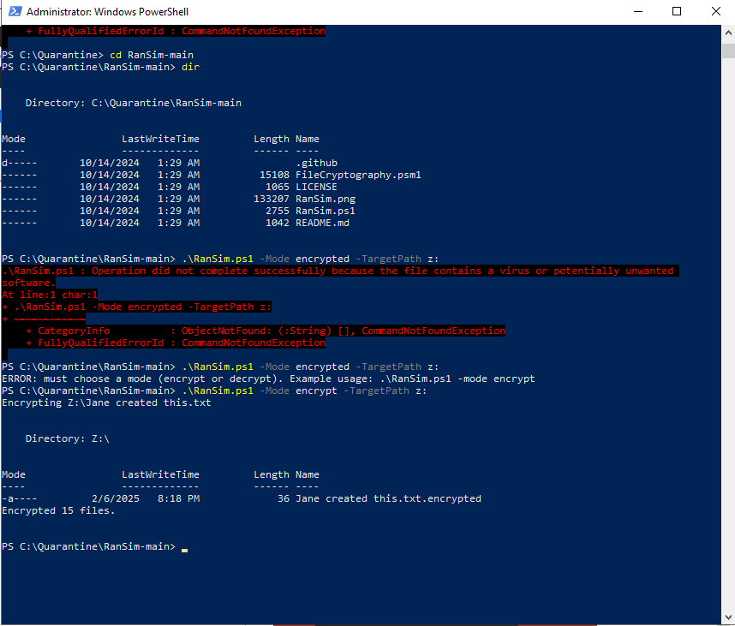
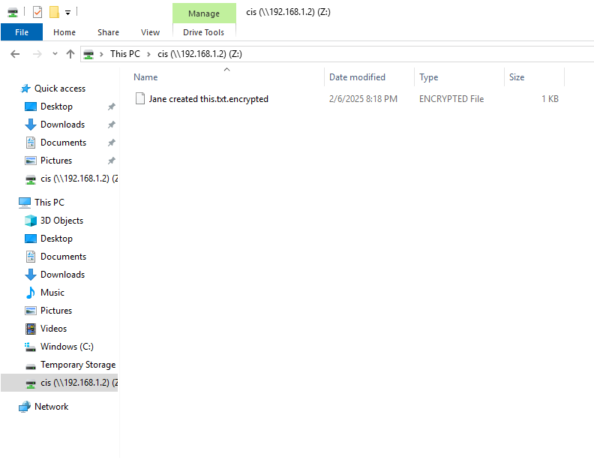
RanSim Demonstration of Ransomware Effects
RanSim simulation:
Command: .\RanSim.ps1 -Mode encrypt -TargetPath z:\
Shows how different permissions limit encryption:
Full Control: Encrypts all files
Read Only: Few or no files affected
Powershell (Admin) to run RanSim script
We can see Jane’s file has been encrypted and no longer contains her plaintext password which she entered. Opening the file will show the reader an unintelligible set of characters. The threat actor would then hold this file for ransom, likely while trying to move laterally and gain more control over the system.

Slide 14

Best Practices for Ransomware Defense
Implement Least Privilege for All Users
Assign users the minimum permissions needed to complete their tasks. Avoid giving "Full Control" unless absolutely necessary, as it can allow ransomware to encrypt or delete all files in a folder.
Regularly Review and Audit Permissions:
Conduct routine checks to ensure permissions are aligned with current job roles. Look for any unnecessary permissions and remove them immediately to reduce the attack surface.
Enable Multi-Factor Authentication (MFA):
MFA adds an additional layer of security beyond a single password. This significantly reduces the risk of unauthorized access by making it harder for attackers to compromise credentials.
Maintain Offline Backups and Conduct Ransomware Simulations:
Keep regular backups that are stored offline or in a secure cloud location. Simulate ransomware scenarios regularly to test recovery procedures and ensure all team members know how to respond to an attack.

Slide 15
Conclusion and Takeaways
By following these best practices for permission management and ransomware defense, I’ve learned how critical it is to strike a balance between collaboration and security.
Properly managing permissions not only ensures smoother teamwork but also protects files from unauthorized access or malicious attacks.
Consistent reviews, MFA, and reliable backups are essential to maintaining a secure, resilient environment.
Thanks for your time!

